Slide 1
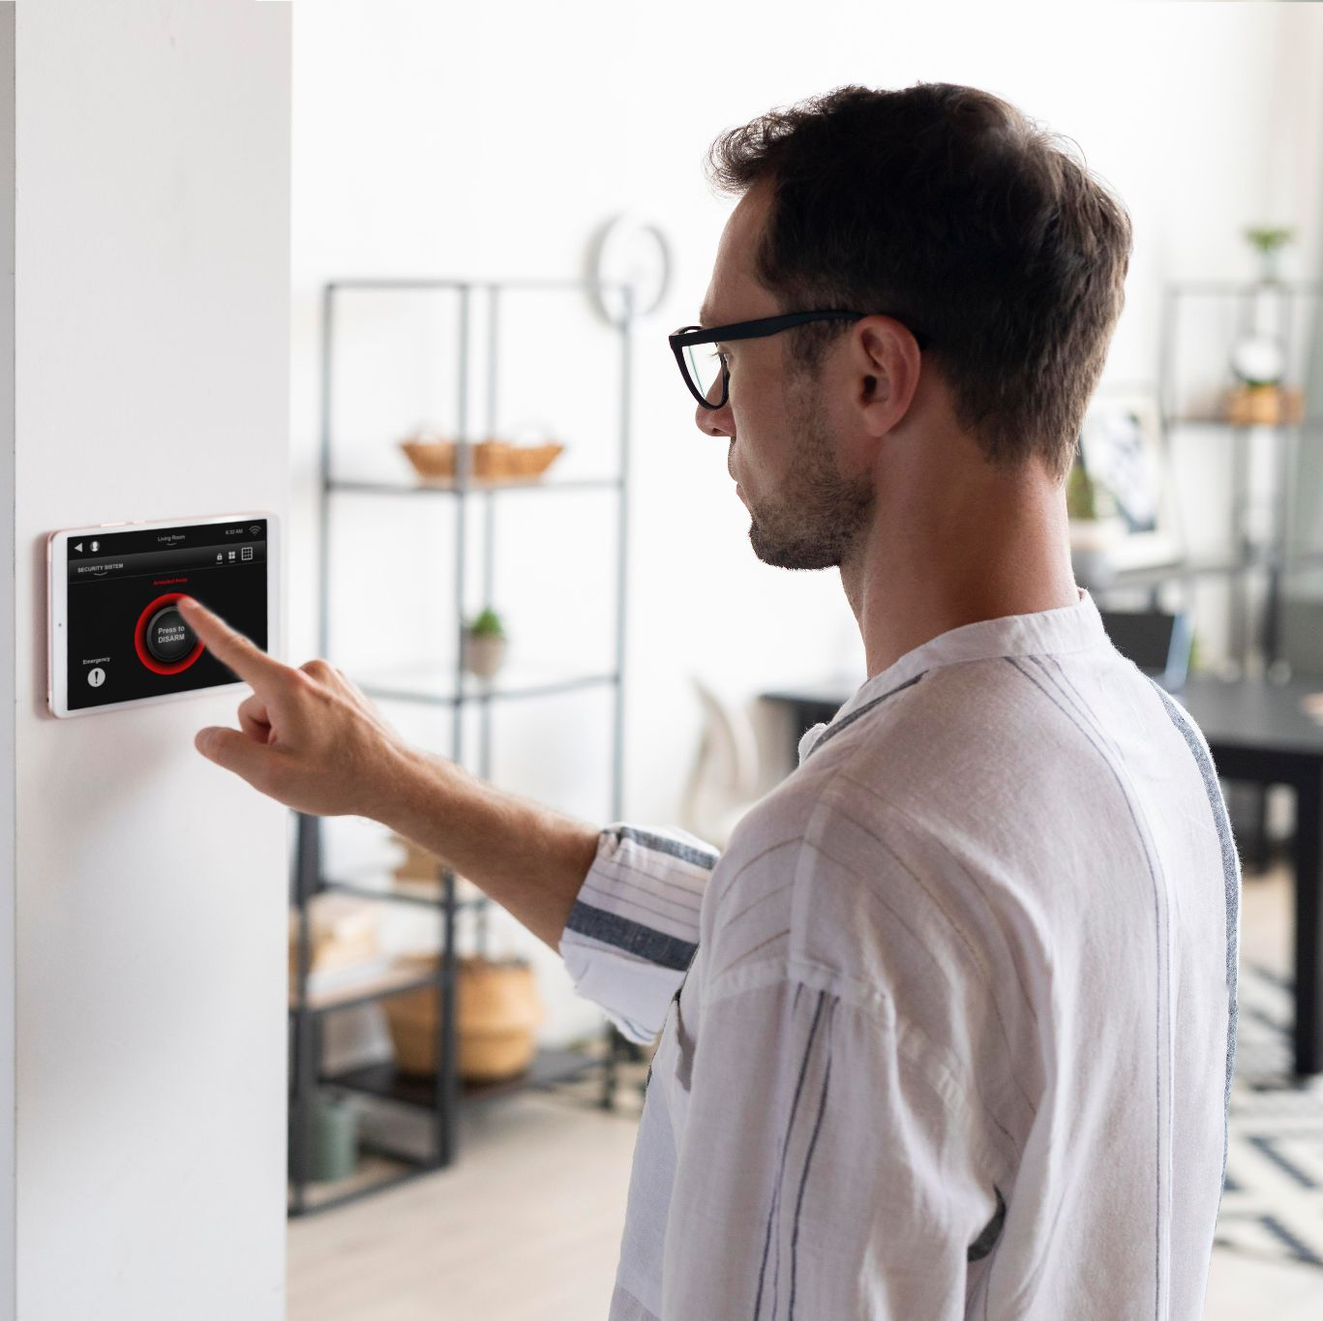
SMART HOME CONSULTATION
Adora Naomi Fernandes- M00793012
Rehab Mulla -

Slide 2
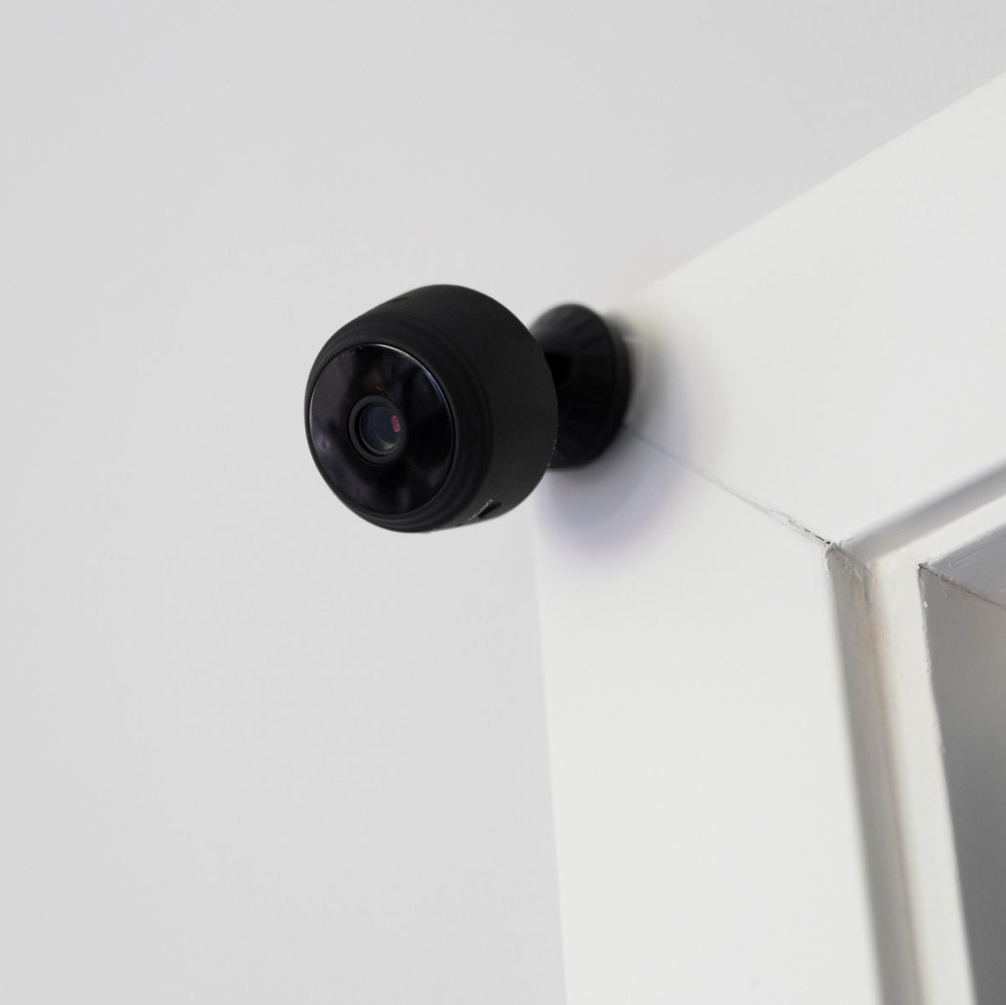
SMARTWAYS
Our aim is to design and sell custom-made smart homes for our clients.
We make our client’s life smart by providing homes with pre-installed smart devices and sensors that will provide assistance in their daily lives.

Slide 3
ABOUT THE PROJECT
STARTER HOMES
FAMILY HOMES
SHELTERED ACCOMDATIONS
Venus has a beautiful name and is the second planet from the Sun
It’s the closest planet to the Sun and the smallest one in the Solar System
Despite being red, Mars is actually a cold place. It’s full of iron oxide dust

Slide 4
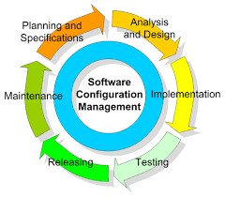
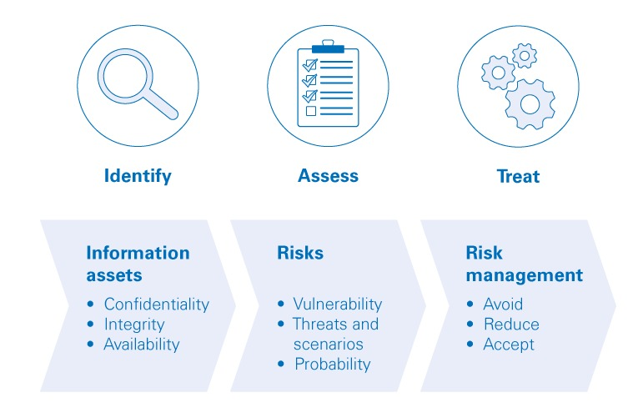
SYSTEMS
WE BELIEVE THAT THESE TWO SYSTEMS ARE CRUCIAL FOR
CONSISTENT FUNCTIONING OF OUR SMART HOMES.
CONFIGURATION MANAGEMENT SYSTEM:
Creates consistency for the device’s performance.
Maintains the device’s functionality for the long run.
SECURITY MANAGEMENT SYSTEM:
Provides security standards to protect user’s sensitive
information.

Slide 5
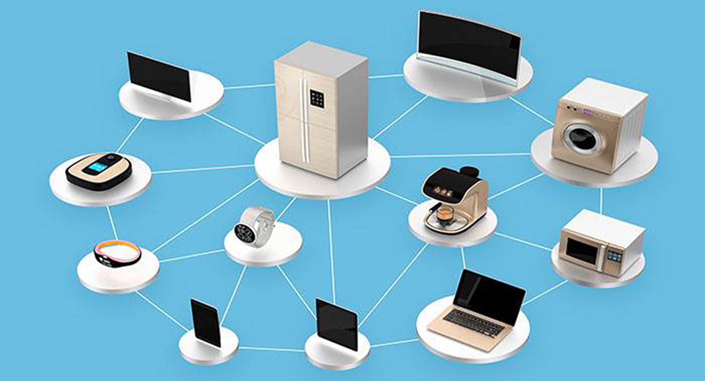
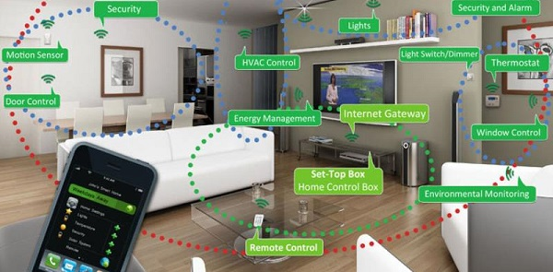
HARDWARE
Hardware can be categorized into SMART DEVICES and SENSORS. Our company provides furnished smart homes with top-quality hardware.
SMART DEVICES
We have selected specific devices keeping in mind our client requirements, which are compatible with our choice of platform, Google Assistant. These devices include Nest Cam, Smart Locks, Smart Fridge, etc.
SENSORS
Sensors are able to detect any movement or change in the environment and automatically respond according to the situation. These devices include Nest Smoke Alarms, Motion Sensors, etc.

Slide 6



SOFTWARE
COMPONENTS
IOT Software
Gateway Software
Smartphone App

Slide 7
IOT SOFTWARE
Hardware and software make up the majority of IoT devices.
Even low-cost IoT devices can now be quite sophisticated.
With powerful microprocessors/microcontrollers running full software stacks.
Stacks' primary purpose is to connect the sensor/actuator to the outside world via a wired or wireless connection.

Slide 8


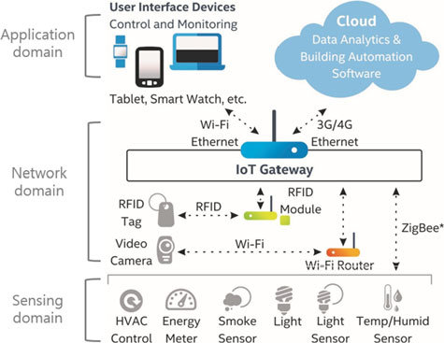



GATEWAY SOFTWARE
Zigbee and Z-Wave protocols are used by most IoT devices
use relatively little power
have a long-range of transmission.
Wi-Fi is the most common local network
IoT gateway is being used to link the gadgets to the local network

Slide 9

SMARTPHONE APP
Swiftly become the most widely used digital device.
Plays an essential role in today's smart homes.
used in smart homes installations to carry out various tasks.
Onboarding devices, monitoring sensors, turning actuators on/off, and establishing rules.

Slide 10
PLATFORM
The use of Google's Knowledge Graph – Google Home has the advantage of accessing the entire Knowledge Graph of Google. This is why Google's voice response is better than other voice-controlled devices and apps.
Can recognize different voices – Google Home can recognize when other members of your family are talking, resulting in personalized answers for each person.
Firmware Updates- Our core smart devices are based on Google's ecosystem. Updates of firmware or patches that fix security flaws and bugs can be tracked and applied using the Google Home app.

Slide 11
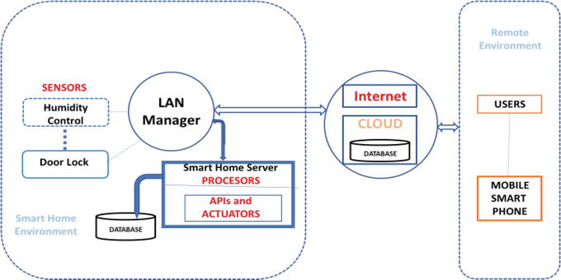
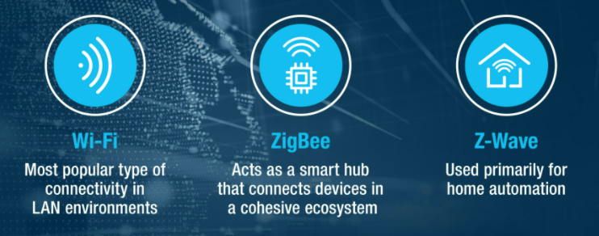
NETWORK
IoT Cloud Software
We believe that the key components of smart homes, such as assessing house conditions, regulating appliances, and controlling home access, can be enabled by using sensors, actuators, and the database included within the IoT Cloud Software.
Notes:
Sensors to collect internal and external home data and measure home conditions. These sensors are connected to the home itself and to the attached-to-home devices. These sensors are not internet of things sensors, which are attached to home appliances. The sensors’ data is collected and continually transferred via the local network, to the smart home server.
Processors for performing local and integrated actions. It may also be connected to the cloud for applications requiring extended resources. The sensors’ data is then processed by the local server processes.
A collection of software components wrapped as APIs, allowing external applications execute it, given it follows the pre-defined parameters format. Such an API can process sensors data or manage necessary actions.
Actuators to provision and execute commands in the server or other control devices. It translates the required activity to the command syntax; the device can execute. During processing the received sensors’ data, the task checks if any rule became true. In such case the system may launch a command to the proper device processor.
Database to store the processed data collected from the sensors [and cloud services]. It will also be used for data analysis, data presentation and visualization. The processed data is saved in the attached database for future use.
It follows a rule bases system.

Slide 12
STANDARD

Slide 13
Our Recommendation

Slide 14
SMART STARTER HOME

Slide 15
SMART FAMILY HOMES

Slide 16
SMART SHELTERED ACCOMMODATIONS

Slide 17
ISSUES WHILE INTEGRATING DIFFERENT TECHS IN OUR SMART HOMES

Slide 18
ISSUES AND THEIR SOLUTIONS
ISSUE
SOLUTION
ISSUE
SOLUTION
Smart Device hard to control
Shortlist easy-to-control devices
Smart Devices don’t connect with each other
Single Network Connection and it should be of high bandwidth
ISSUE
SOLUTION
Power outage leads to smart devices not working
A generator will be provided for the backup power supply.

Slide 19
ISSUE DIFFICULT TO RESOLVE
MALFUNCTION IN NETWORK CONNECTIVITY
IoT DEVICES NOT POWERFUL ENOUGH TO RUN ANTI-MALWARE SOLUTIONS

Slide 20
TANGIBLES
Inexpensive
Virtual Assistant better than the competition
Better Security
Faster Integration with Devices
Inexpensive

Slide 21
INTANGIBLES
Google is a well-known brand
Assistant can respond to more commands and can make custom commands.
Automation makes processes easy.
Most devices offer compatibility with Google’s Services.

Slide 22
BUDGET
£174,726.48
£209,379.3
£52707.47
Starter Homes
Family Homes
Sheltered Accommodation for Elderly

Slide 23
£436,813.25
TOTAL BUDGET

Slide 24
COST RECOVERY
Charge Higher Rents
Offer Smart Services on a Subscription Based Model
Offer timely maintenance of the smart devices.
Offer security packages separately.

Slide 25
COST RECOVERY
Estimated Time needed to recover costs:
A subscription bundle can be offered to family and starter homes.
A monthly subscription of 500 GBP will take roughly 3 and a half years to recover the cost of making each starter home smart.
A monthly subscription of 1000 GBP will take 3 years to recover the cost of each family home.
A monthly subscription of 800 GBP will take almost 4 years to recover the cost of the sheltered accommodation.

Slide 26
THANKS
Do you have any questions?
youremail@freepik.com
+91 620 421 838
yourcompany.com
PLEASE KEEP THIS SLIDE FOR ATTRIBUTION

Slide 27
RESOURCES

